Slide 1

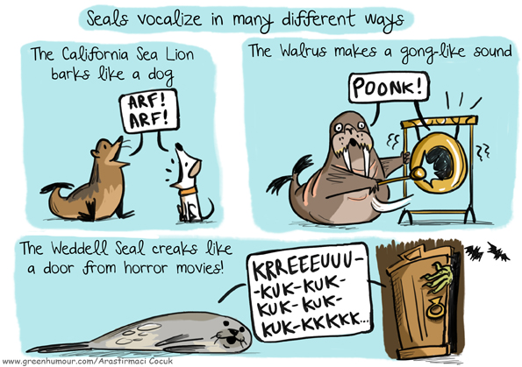

yaizapilar.pozogalvan@research.atu.ie
Notes:
Click on the icon to access the paper

Slide 2
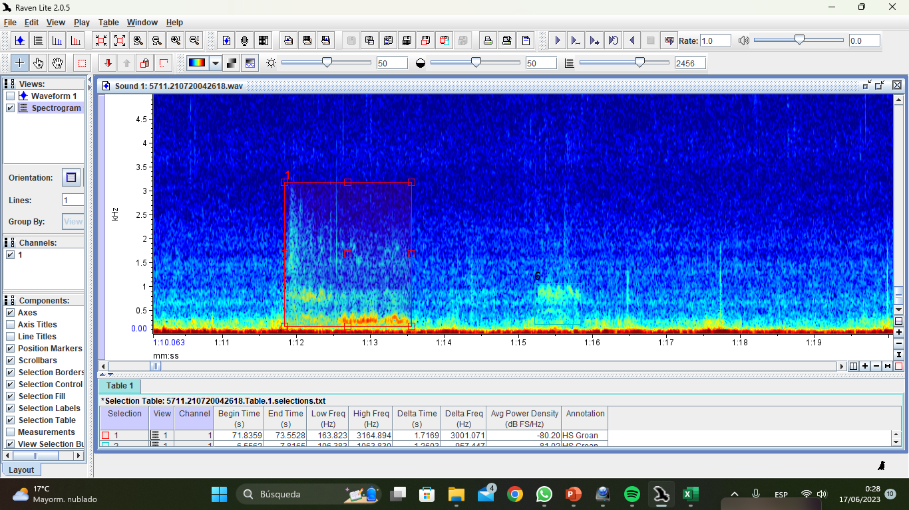


Data Visualisation
Raven Lite:
Spectrograms at 2456 FFT band resolution
Max. frequency of 4 kHz
Time resolution of 10 s
Brightness and contrast adjusted depending on the file
Call Parameters (selection table)
Low and high frequency (Hz)
Frequency range (Hz)
Call duration (s)
Raven Lite
Average power density (dB FS/Hz)
Notes:
Click on the icon to download the software

Slide 3
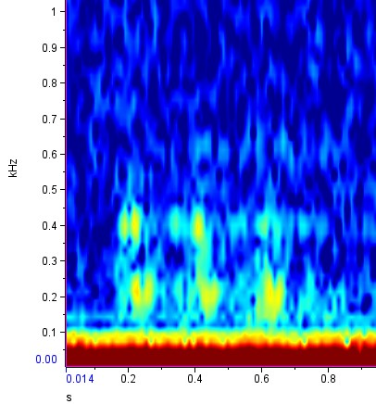

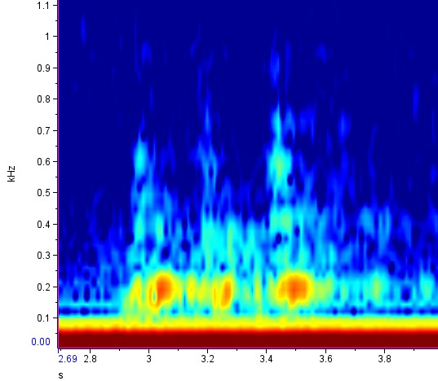
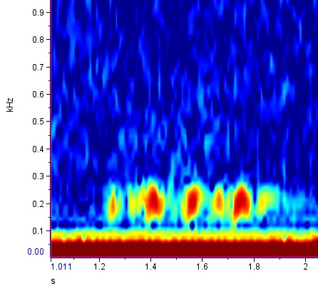
How do grey seals sound?
Guttural rupe
Different shapes. Most of them found in series of 3 elements; however, pulses of 1-9 elements were also recorded. Important role of this call in the communication, territorial defense, and mating of the species (Pérez Tadeo, 2022).

Slide 4
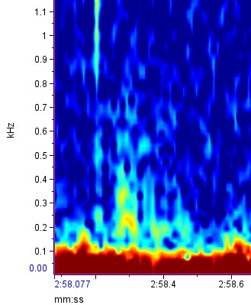
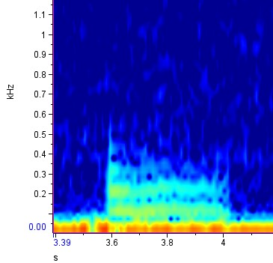
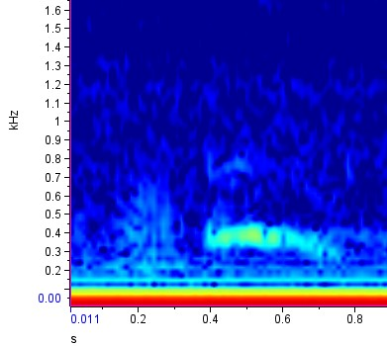
How do grey seals sound?
Rupe A
Rupe B
Rupe C
First part like “Rupe A”; second part similar to “moan”
Cone shape and “pu” sound
Sound more constant (“puuu”)
Notes:
Rupe A and B were often emitted in succession
Suggested to be uttered by females during female-male social interactions (Asselin et al., 1993; McCulloch, 2000)

Slide 5
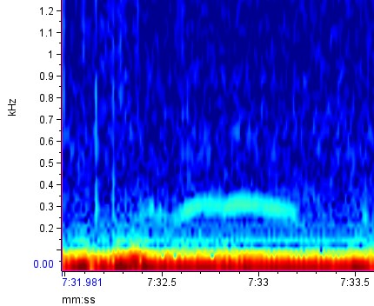
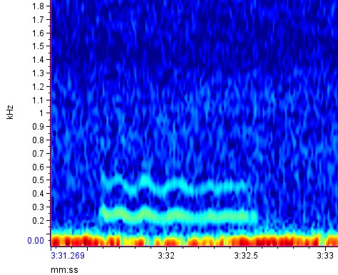
How do grey seals sound?
Moan
5713.210902110002
Different shapes and frequencies. Emitted by both males and females in a social interaction context (McCulloch, 2000; Schneider, 1974)

